Slide 1
PROJECT DEMO
TOPIC -File compression using huffman algorithm
SRN-PES1UG20CS670
NAME-Pavan Kumar Nuthi

Slide 2
Content
1)The problem statement
2)About huffman algorithm
3)Approach
4)Demo
5)Analysis of the results
6)Conclusion and Future work

Slide 3
1)The problem statement
Usage of huffman algorithm to compress a given text file.
Given a text file the goal is to store the text file in lesser amount of space and able to recover the original file without loss of information.
In order to achieve this there must be proper encoding methods so that the data is not lost when trying to achieve compression.
Huffman encoding is suitable algorithm to achieve data compression without loss of data.

Slide 4
2)About huffman algorithm
Huffman algorithm is a lossless data compression algorithm.We assign variable length codes to input character,lengths of the assigned codes are based on the frequencies of the corresponding characters.The most frequent characters gets the smallest code and the least frequent character gets the largest code.
The codes are assigned to characters in such a way that that no code is the prefix of the other code.
Character appearing most is given the smallest length code.This is important in reducing the overall size of the compressed encoded file.

Slide 5
Assigning code to the characters
The steps to be followed are-
1)Take the sample input data(text file).
2)Calculate the frequency of each character .
3)Then the frequency is assigned has a value to a given character.
4)Then the frequencies are stored in a priority queue(Min heap) in our case in order to build a huffman tree.

Slide 6
Building the Huffman tree
1)Two nodes are removed from the min heap (lowest frequency character will be removed first).
2)Sum the frequencies of both nodes and form a new node.
3)Make this parent to the two removed nodes with the left child of the parent being preferably the low frequency node.
4)Then the new node is inserted into the min heap.
5)The above process is repeated till there is only one node in the min heap.

Slide 7
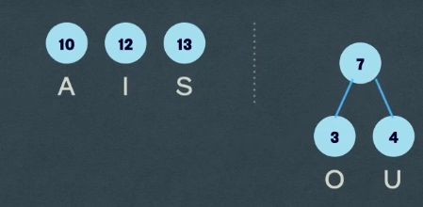

Assigning codes using the huffman tree
Assign 0 to the left edges of the tree and 1 to the right edges of the tree.
Traverse the tree from the root and build the codes for each character.
Example-

Slide 8
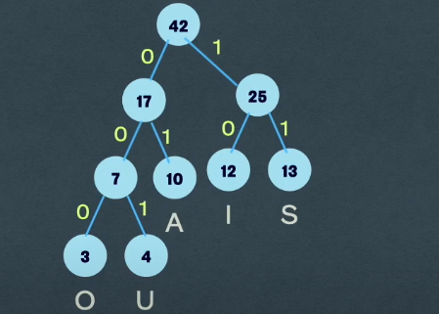
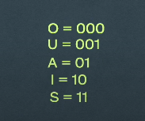
Assigning codes using the huffman tree

Slide 9
3)Approach
Compression
1)Taking in the input file and updating the frequency for each character of the file.
2)Building priority queue(Min heap in this case) from the frequencies.
3)Building huffman tree by selecting 2 least frequently occurring nodes and forming a new node having frequency as sum of them .
4)Assign codes to the character by traversing the formed huffman tree.

Slide 10
Compression Continued…
5)Encode the input text by replacing the characters with its corresponding code.
6)If overall length of final encoded bit streams is not 128 bits then its made 128 bits by adding padding information (This step is necessary because different characters have variable length of the codes this ensure uniformity).Then 8 bits are converted into decimal so we get 16 such decimal values.
huffman code for that character} = 128 bits divided into 16 decimal numbers. Every number represents 8 bit binary number.
eg: {127 - code.length()} * '0' + '1' (representing start bit) + code = 128 bits
It is converted to 16 * 8-bit decimal numbers = 128 bits
7)Then the padding information for each character is stored so that we don’t lose out the information of until where the actual code is and how much is the padding information.

Slide 11
Decompression
1)Read the .huf(binary file) file which stores the encoded information.
2)We need to read the corresponding padding information for the character so that we remove the padded bits.
3)Decode the bits read the bits and replace the valid Huffman code bits with the character value.
4)Save the decoded data back into the output file(getting the original data back)

Slide 12
4)Demo
To visual studio code to show the demo.

Slide 13
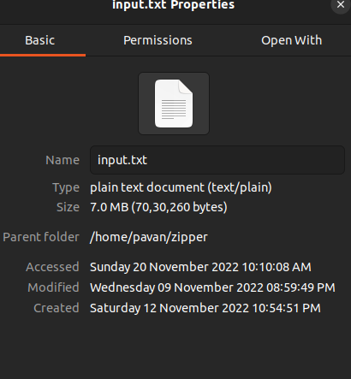
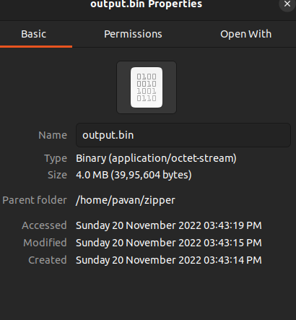
5)Analysis of the results
The compression ratio is approximately 50%.The size if 7 MB before compression and 4MB later.

Slide 14
6)Conclusion and future works
This shows that huffman encoding can be used for lossless compression since the new file which is obtained from the encoded file has the same contents has the original file since the encoded file(.huf file) makes sure all the information of the original file stored appropriately.
It can be extended to audio and video files with other implementation strategies.

Slide 15
Thank you!

